Slide 1
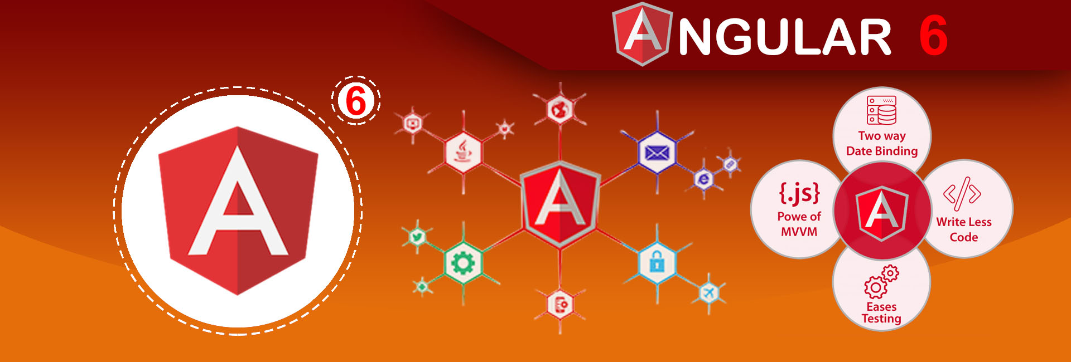

Slide 2
Angular 6
Course Coverage

Slide 3
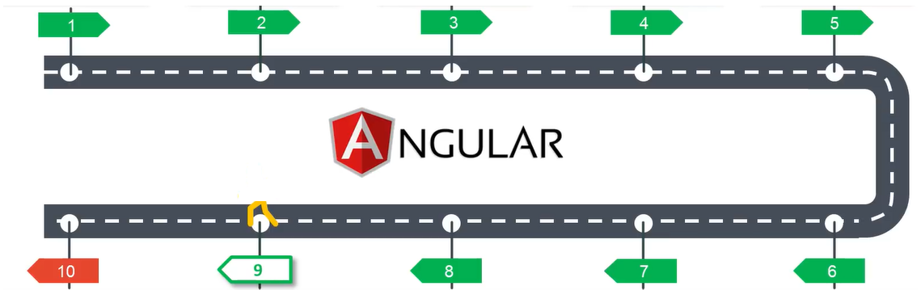
Course Agenda
Angular
Introduction
Installation &
Project Creation
Angular
Components
Angular
Data Binding
Angular
Modules
Angular
Services
Angular
Forms
Angular
Pipes
Angular
Template & Style
Angular
Directives

Slide 4
What is SPA?

Slide 5
Traditional Way Vs Single Page Application

Slide 6
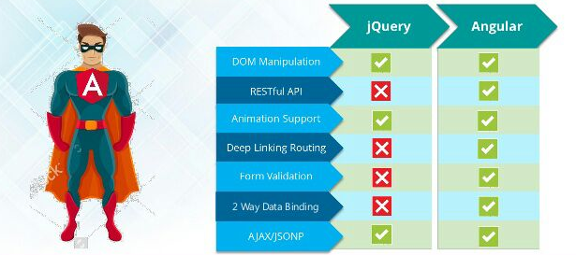
Angular Vs jQuery

Slide 7
What is Angular?
Framework to build Client side applications.
Great for SPA
Modular Approach
Reusable code
Development quicker and easier
Unit testable
Google + MS

Slide 8
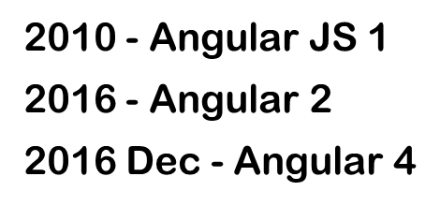
Angular History

Slide 9
Angular Version Changes
I didn’t even get Angular 6 yet and there is already Angular 7?
Angular upgraded twice a year

Slide 10
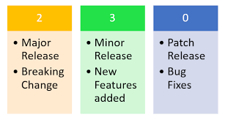
Semantic Versioning
Angular 6 April 2018
Angular 7 Oct 2018
Angular versions are backward compatible.

Slide 11
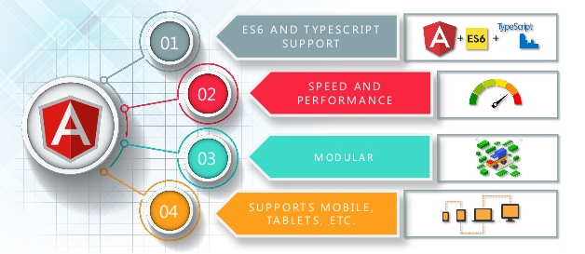
Angular Features

Slide 12
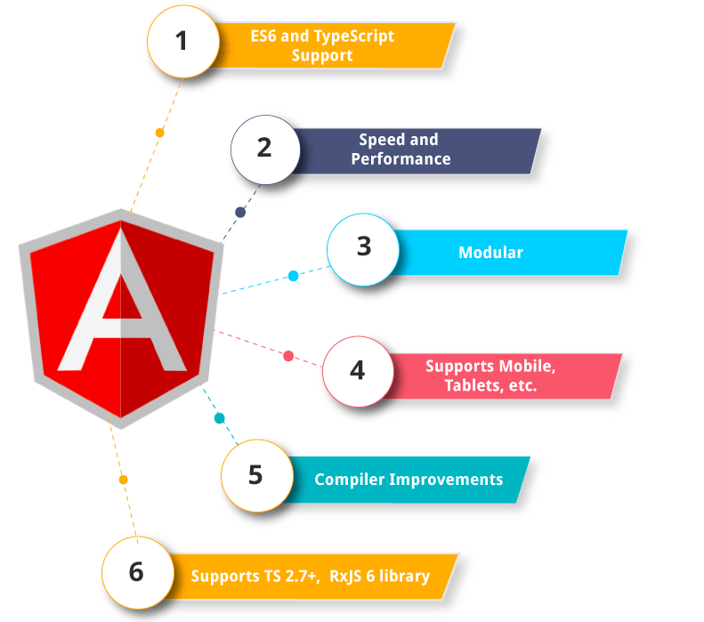
Angular Features

Slide 13
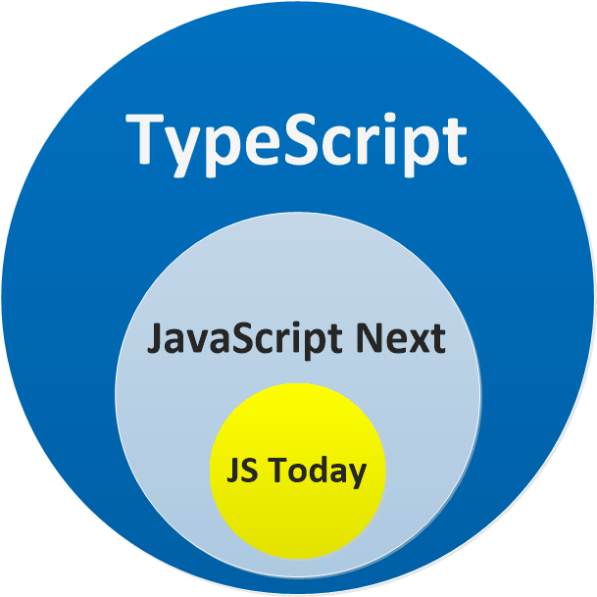
What is type script?
Type Script is a super set of Java Script.

Slide 14
Getting Started
Prerequisites:
HTML,CSS,JS
Type Script
Development Environment
Node JS
Node Package Manager (NPM)
Angular CLI
Text Editor Visual Studio Code, Atom, Sublime

Slide 15
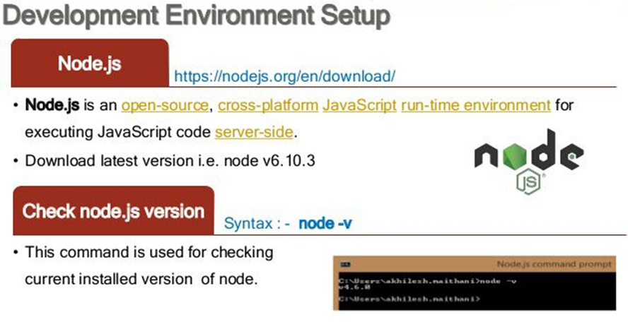
Development Environment Setup

Slide 16
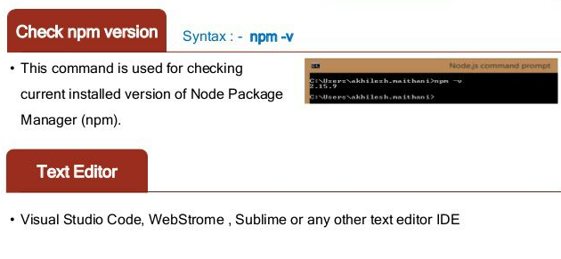
Development Environment Setup

Slide 17
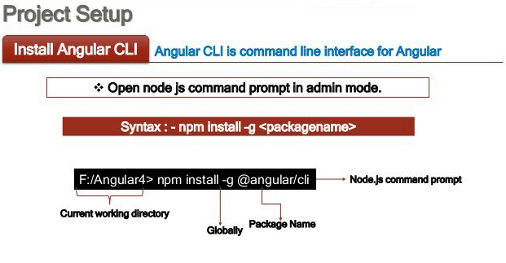
Project Setup

Slide 18
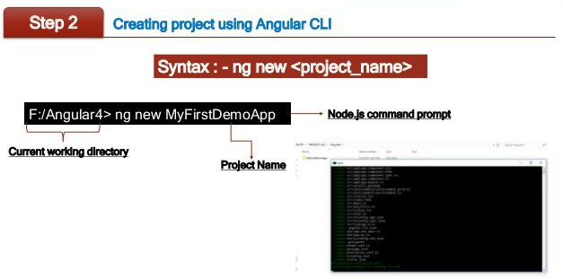
Project Setup

Slide 19
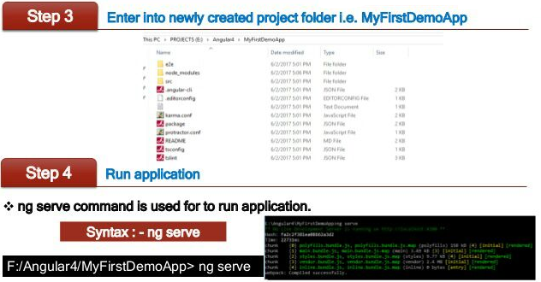
Project Setup

Slide 20
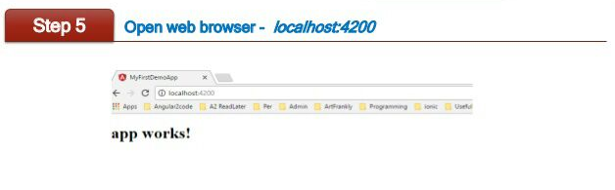
Project Setup

Slide 21
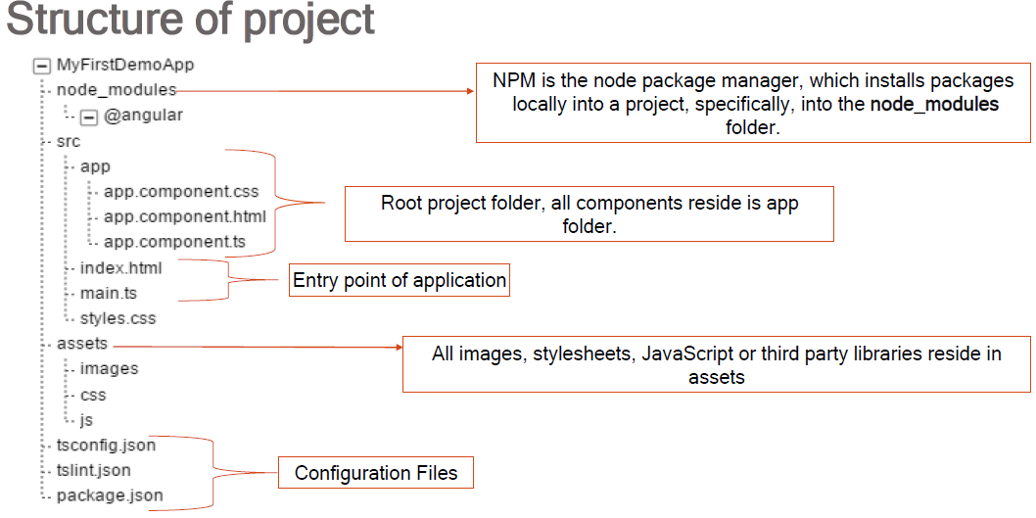
Angular 6 Project Structure

Slide 22
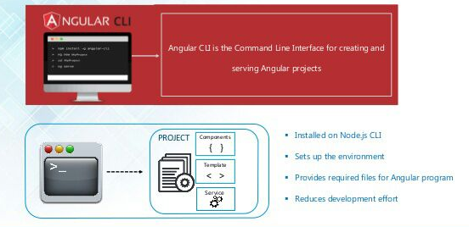
Angular CLI

Slide 23
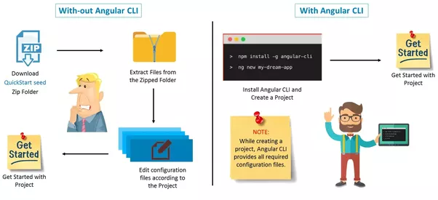
Why Angular CLI?

Slide 24
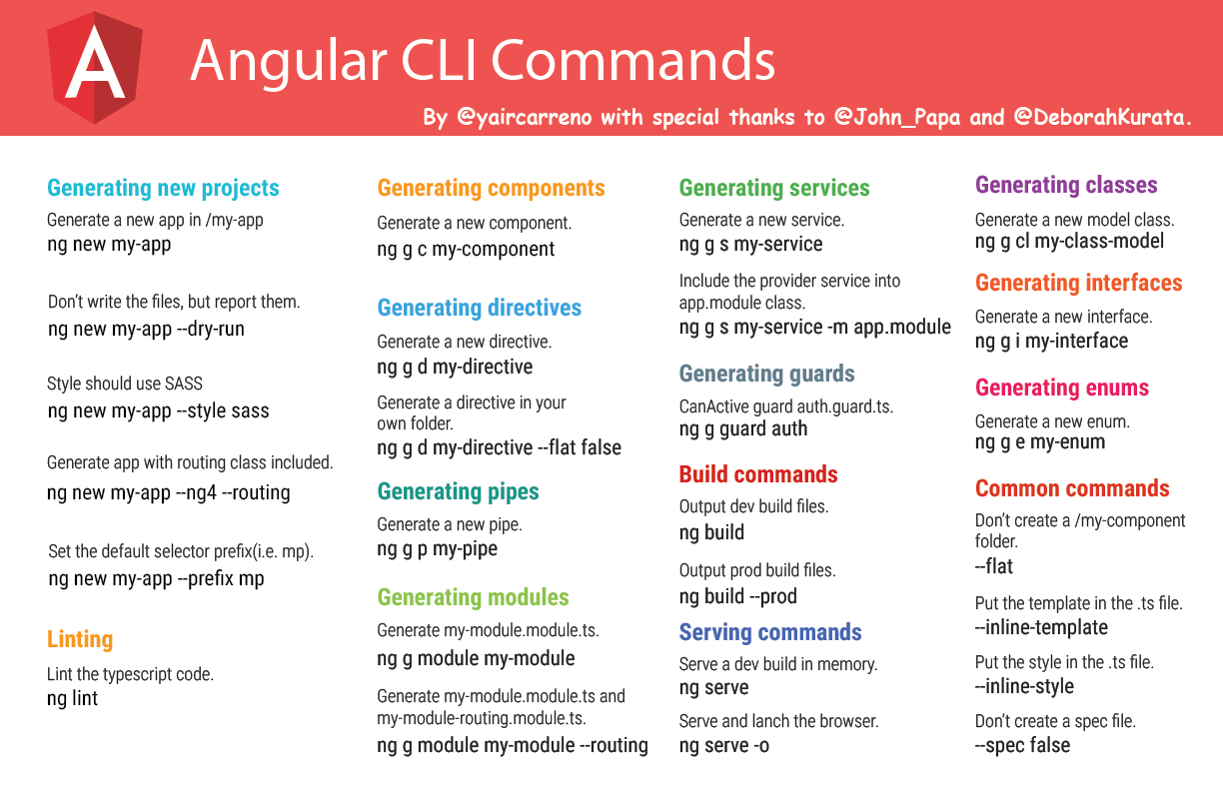

Slide 25
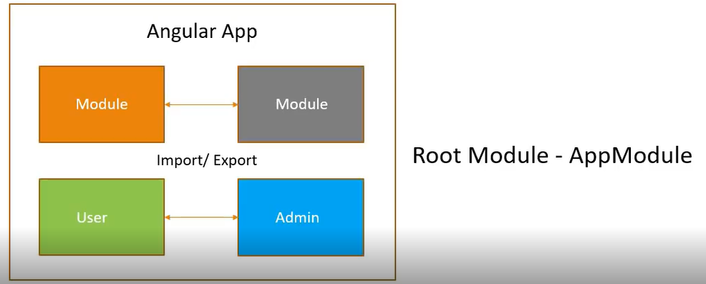
Angular 6 Architecture
Angular application is a collection of individual modules
Every Module represent a feature in the application.
User modules related to the users
Admin modules related to the administration
Angular Modules can be either imported or exported
Every Angular application has 1 module called Root Module or App Module

Slide 26
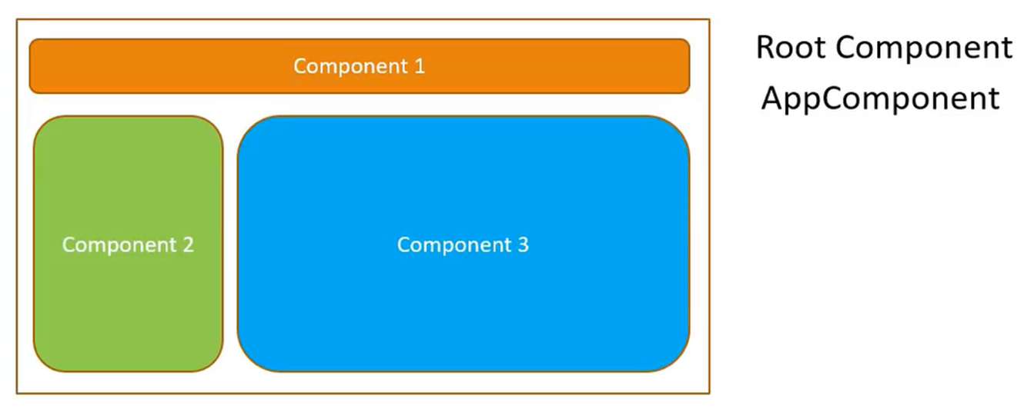
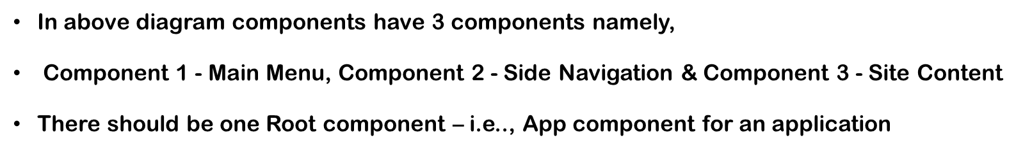
Angular 6 Architecture
Each module has components and services
Components controls the portion of view in the browser

Slide 27
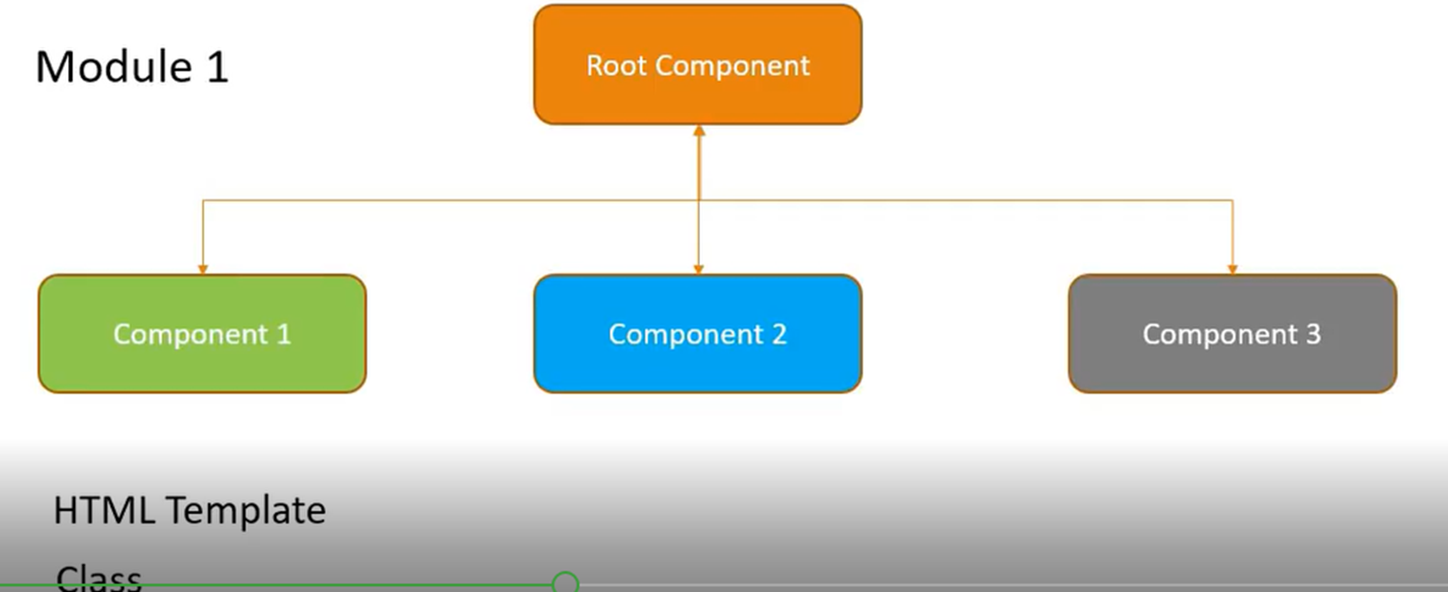
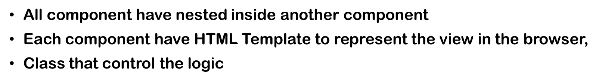
Angular 6 Architecture

Slide 28
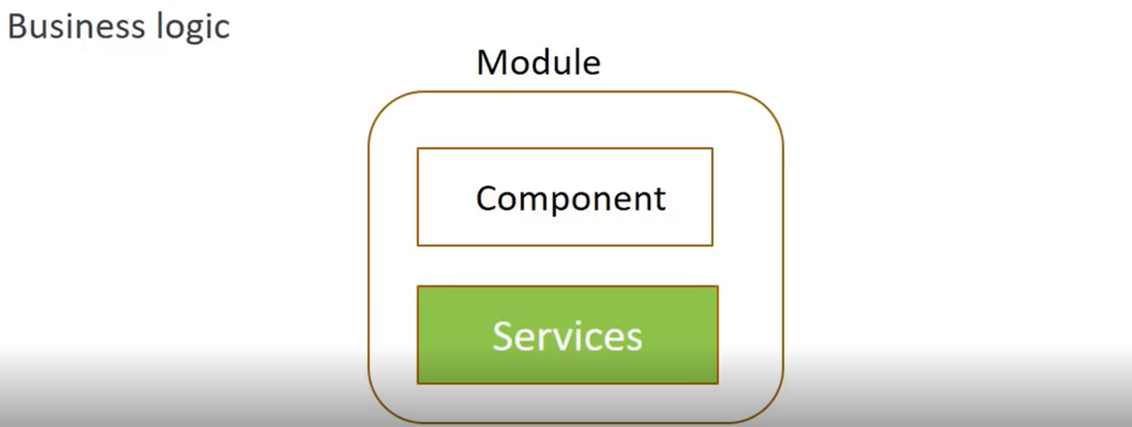
Angular 6 Architecture
Module will have class that contain the business logic of the applications
Module contains Components and Services

Slide 29
Angular 6 Architecture Summary
Angular app contains one or more module
A Module can contain one or more components and services
Each component contains HTML templates + class to control logic of a particular view
Modules have Services - Business Logic of the application
Modules will have a code that import and export as and when required finally render view in the browser

Slide 30
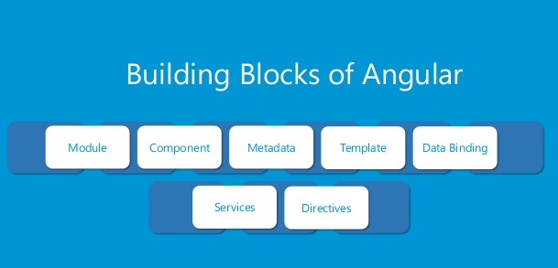
Building Blocks of Angular 6

Slide 31
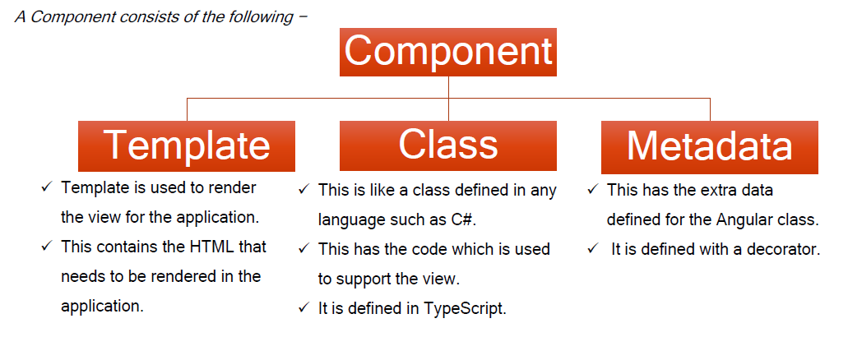
What is Component?

Slide 32
Decorator
A decorator is a function that is invoked with @ prefix and followed by class, methods and property

Slide 33
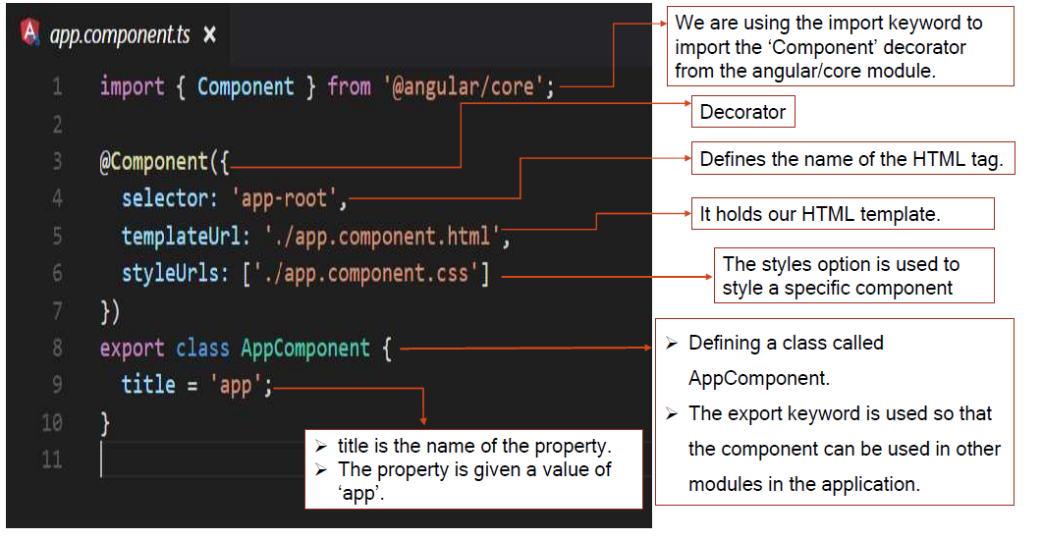
Structure of Component

Slide 34
Creating Component

Slide 35
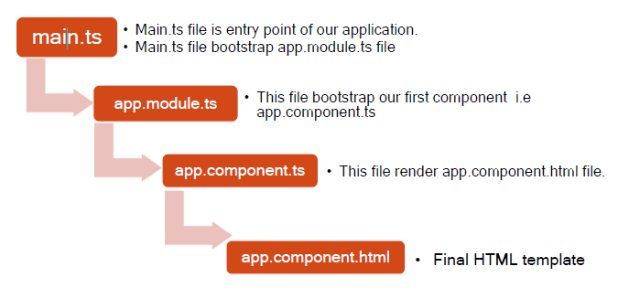
App Works

Slide 36
Template and template url
template: It is used to specify HTML which us shown as an output to the user.
templateUrl: URL to an external file containing a template for the view.

Slide 37
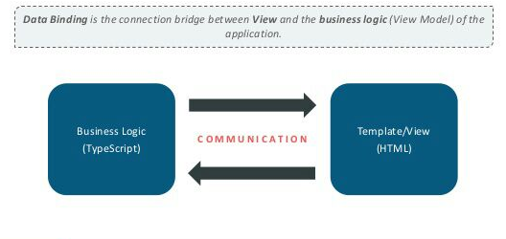
Data Binding

Slide 38
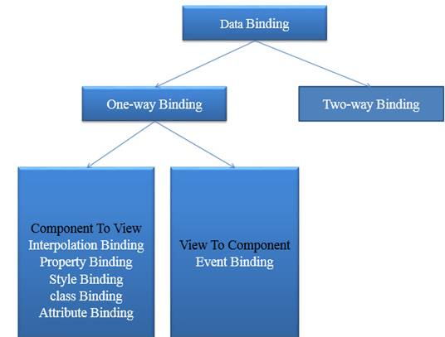
Classification of Data Binding

Slide 39
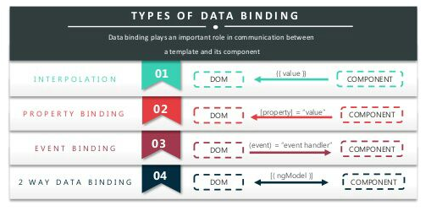
Types of Data Binding

